Slide 1
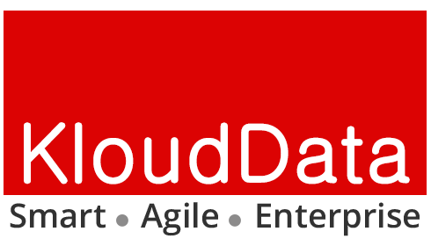
KloudData and Delmock Technologies
Strategic Partnership
Profile: A 5+ year old high growth business software solutions provider
DNA: Trusted partner to its customers & alliances
Customers: 100+ in USA
Offices: Fremont, CA; Columbia, MD
Team Strength: 250+
Vertical Focus: Government, Healthcare, Manufacturing
Expertise: Cloud, Analytics, Enterprise, Mobility, UI/UX for Government, Healthcare, Manufacturing
Profile: Established 10+ year high quality IT services provider
DNA: Satisfies customers' needs via 3-tier service model: Delivering Indispensable Personnel; Using Enduring Best-Practices; and Providing Vital IT Tools
Customers: 30+
Offices: Baltimore, MD
Team Strength: 50+
Vertical Focus: US Federal Government
Expertise: Mission critical IT service, Enterprise Security, and Quality management solutions
Healthcare Analytics
Cybersecurity
Cloud based SaaS
Enterprise Mobility
Enterprise Data Archiving
Enterprise Data Warehousing
IoT Asset Traceability

Slide 2
KloudData and Delmock Technologies
Solution Showcase

Slide 3
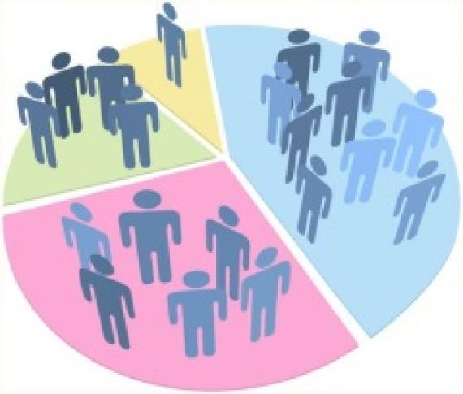
Population Health Analytics
We equip healthcare providers & PHM programs with the tools to
Improve the health of population
Improve experience of care
Reduce per capita costs of health care
Our tools comprises of Risk Stratification Analytics that optimizes care delivery and patient experience and helps identify patients likely to suffer health deterioration or unplanned hospital admissions
Behavioral Risk Stratification – behavioral pattern of the population which can be associated with the risk zones of specific diseases
Financial Risk Stratification - adverse outcome risks of individuals or groups that predict financial burden on patients and healthcare system
Clinical Risk Stratification - predictions to analyze many key factors & allow patient or physicians to assess the risk of adhering treatment type i.s. medical or surgical
Population Health Management to improve the health output of groups using aggregate data and provide a comprehensive clinical picture of patients

Slide 4
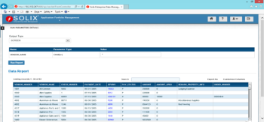
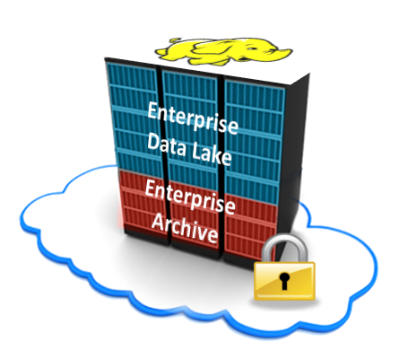
Enterprise Big Data Archiving and Data Lake
STRUCTURED DATA
EMR/EHR
Oracle EBS
SAP
PeopleSoft
Seibel
Baan
Custom Apps
RDBMS
Hadoop Based Solution
Benefits
One Repository
Highly Scalable
Low Cost
Open Data Formats
Cloud Ready
Search + Report + Analyze
UNSTRUCTURED DATA
SharePoint
File Shares
Logs Servers
Web Servers
IoT
Social Media
Media Servers
EMAIL

Slide 5
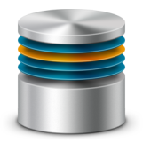
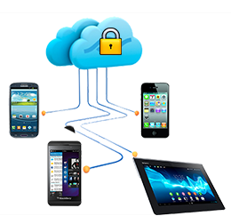
Enterprise Mobility Solutions
Sales Rep Applications
Cloud
KloudData
Mobile Solution
On Premise
Self-Service Applications
Point of Care Applications
Design
Applications
Security
Retail Applications
Application Data
Payroll Processing Applications
SAP App
Industry App
MDM
MAM
Expertise to routinely deliver enterprise mobility solutions for high impact results
Custom App
Fiori
Consumer App
Field App
Early innovator in successfully delivering end-to-end high value mobility solutions across a range of business problems
Middleware Platforms
SAP Mobile 3.0
mUnite
or
or
SAP
Non SAP

Slide 6
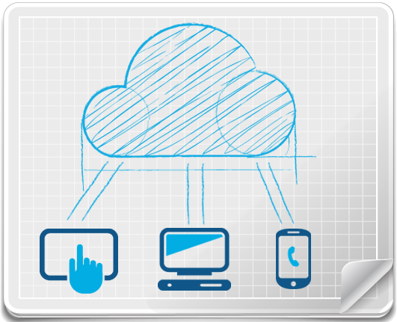
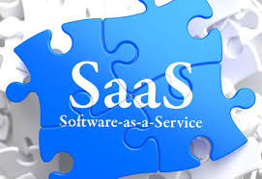
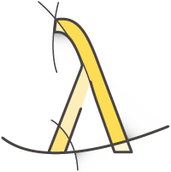
Cloud Based Solutions

Slide 7
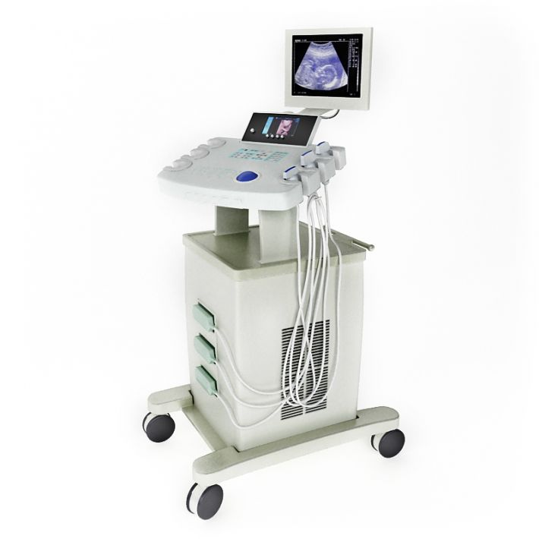
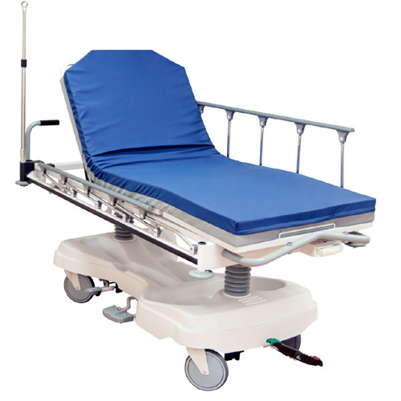
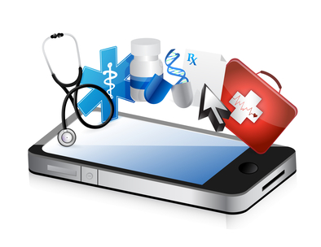
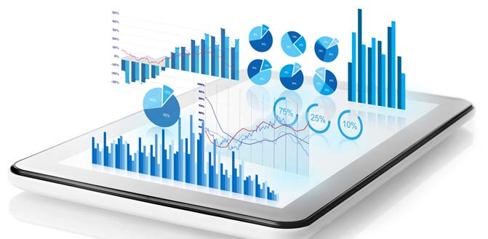
Healthcare Traceability as a Service (TaaS)
Real Time Asset Intelligence
Operational Intelligence
Mobile Intelligence &
Notification Services
Predictive & historical analytics
Optimize resources
Healthcare staff
Medical equipment
Assets
Improve efficiencies and overhead costs
Improved patient satisfaction
Reduce loss and misplacement of medical equipment
Automate and improve asset visibility, traceability
Real time patient, staff and asset tracking
• Clinical equipment
• Wheelchairs, Beds, Stretchers
• IT assets
Real time and accurate process visibility
Status and exceptions alerts and notifications
Email
SMS
Voice
SMS

